Slide 1

VA-ORD efforts establishing a COVID-19 biorepository network
Dial in (Main): (914) 614-3221
Dial in (Alt): (914) 339-0024
Access Code: 646-849-979
Slides in “Handout” Tab
Office of Research & Development
May 28, 2020

Slide 2
Agenda
Introduction to Working Group and Charge
  Holly Krull
Key Characteristics of the Biorepository System
  Abhinav Diwan, Vince Marconi, Emerson Padiernos
Governance and Structure of Biorepository System
  Abhinav Diwan, Vince Marconi, Emerson Padiernos
Sample Collection
  John Harley, Carey Shive, Jason Wertheim
Sample Acquisition, Shipping, Storage and Tracking
  Saiju Pyarajan
Protocol Development
  Vicky Davey, Rich Dennis
Summary and Future Directions
  Holly Krull

Slide 3
Charge
The charge of this working group is to develop an overall plan for biospecimen banking at VAMCs to be presented to the Chief Research and Development Officer. The plan should include recommendations on:
  participating in on-going national biospecimen collections and collaborations
  development of VA biospecimen collection(s)
  governing policies and procedures for VA samples
    ethical considerations
    collection of biospecimens
    type of biospecimens collected
    local versus central storage
  use of samples
    cooperation and coordination across investigator participants
    availability for research collaborations with VA and non- VA investigators
  development of an executive oversight committee

Slide 4
Working Group Members
Jeffrey Curtis, MD; VA Ann Arbor Healthcare System
Richard Dennis, PhD; John L McClellan VA Medical Center
Abhinav Diwan, MD; VA St. Louis Healthcare System
John Harley, MD, PhD; Cincinnati VA Medical Center
Stuart Isaacs, MD; Corporal Michael J. Crescenz VAMC
Vincent Marconi, MD; Atlanta VA Medical Center
Shyam (Sam) Mohapatra, PHD, MBA; James A Haley VA Hospital
Emerson Padiernos, ANP-BC, CRNP; Boise VA Medical Center
Saiju Pyarajan, PhD; VA Boston Health Care System
Carey Shive, PhD; Louis Stokes Cleveland VA Medical Center
Peruvemba Sriram, MD; Malcom Randall VA Medical Center
Jason Wertheim, MD, PhD; Southern Arizona VA Healthcare System
Mark Zimering, MD; VA New Jersey Health Care System
VA-ORD
Jane Battles, PhD
Pauline Cilladi-Rehrer
Christopher Bever, MD, MBA
Vicky Davey, PhD, MPH
Holly Krull, PhD
Ron Przygodzki, MD

Slide 5
Key Characteristics of the Biorepository System
Vision and Purpose
Guiding Principles
Priorities and Values
Establishment and Oversight

Slide 6
Vision and Purpose
Advance
understanding of
disease and further
diagnostic, therapeutic
and prevention strategies for
immediate deployment in clinical
environments
Create a comprehensive repository of COVID-19 and other EID specimens and associated data available for research studies
Model repository for other diseases and conditions
Enhance collaboration with external partners focused on emerging infectious diseases research
Harmonize specimen and data collection
Vision
Purpose
Goals

Slide 7




Guiding Principles
Maximize collection of high-quality specimens and data ethically and efficiently
Harness clinical and scientific strengths of the VA in order to create synergistic effects with pre-existing efforts
Leverage the administrative and regulatory capabilities of the VA to ensure accountability and compliance
Provide an effective mechanism to review, approve and distribute specimens and data to scientific partners

Slide 8


Priorities and Values
Patient and Community engagement
Informed Consent and confidentiality
Adherence to policy requirements* particularly with respect to genetic research
Ensure qualified personnel are involved in the conduct of research
Close monitoring of costs, space, equipment and facility needs
*International Compilation of Human Research Standards and Safe Harbor practices

Slide 9

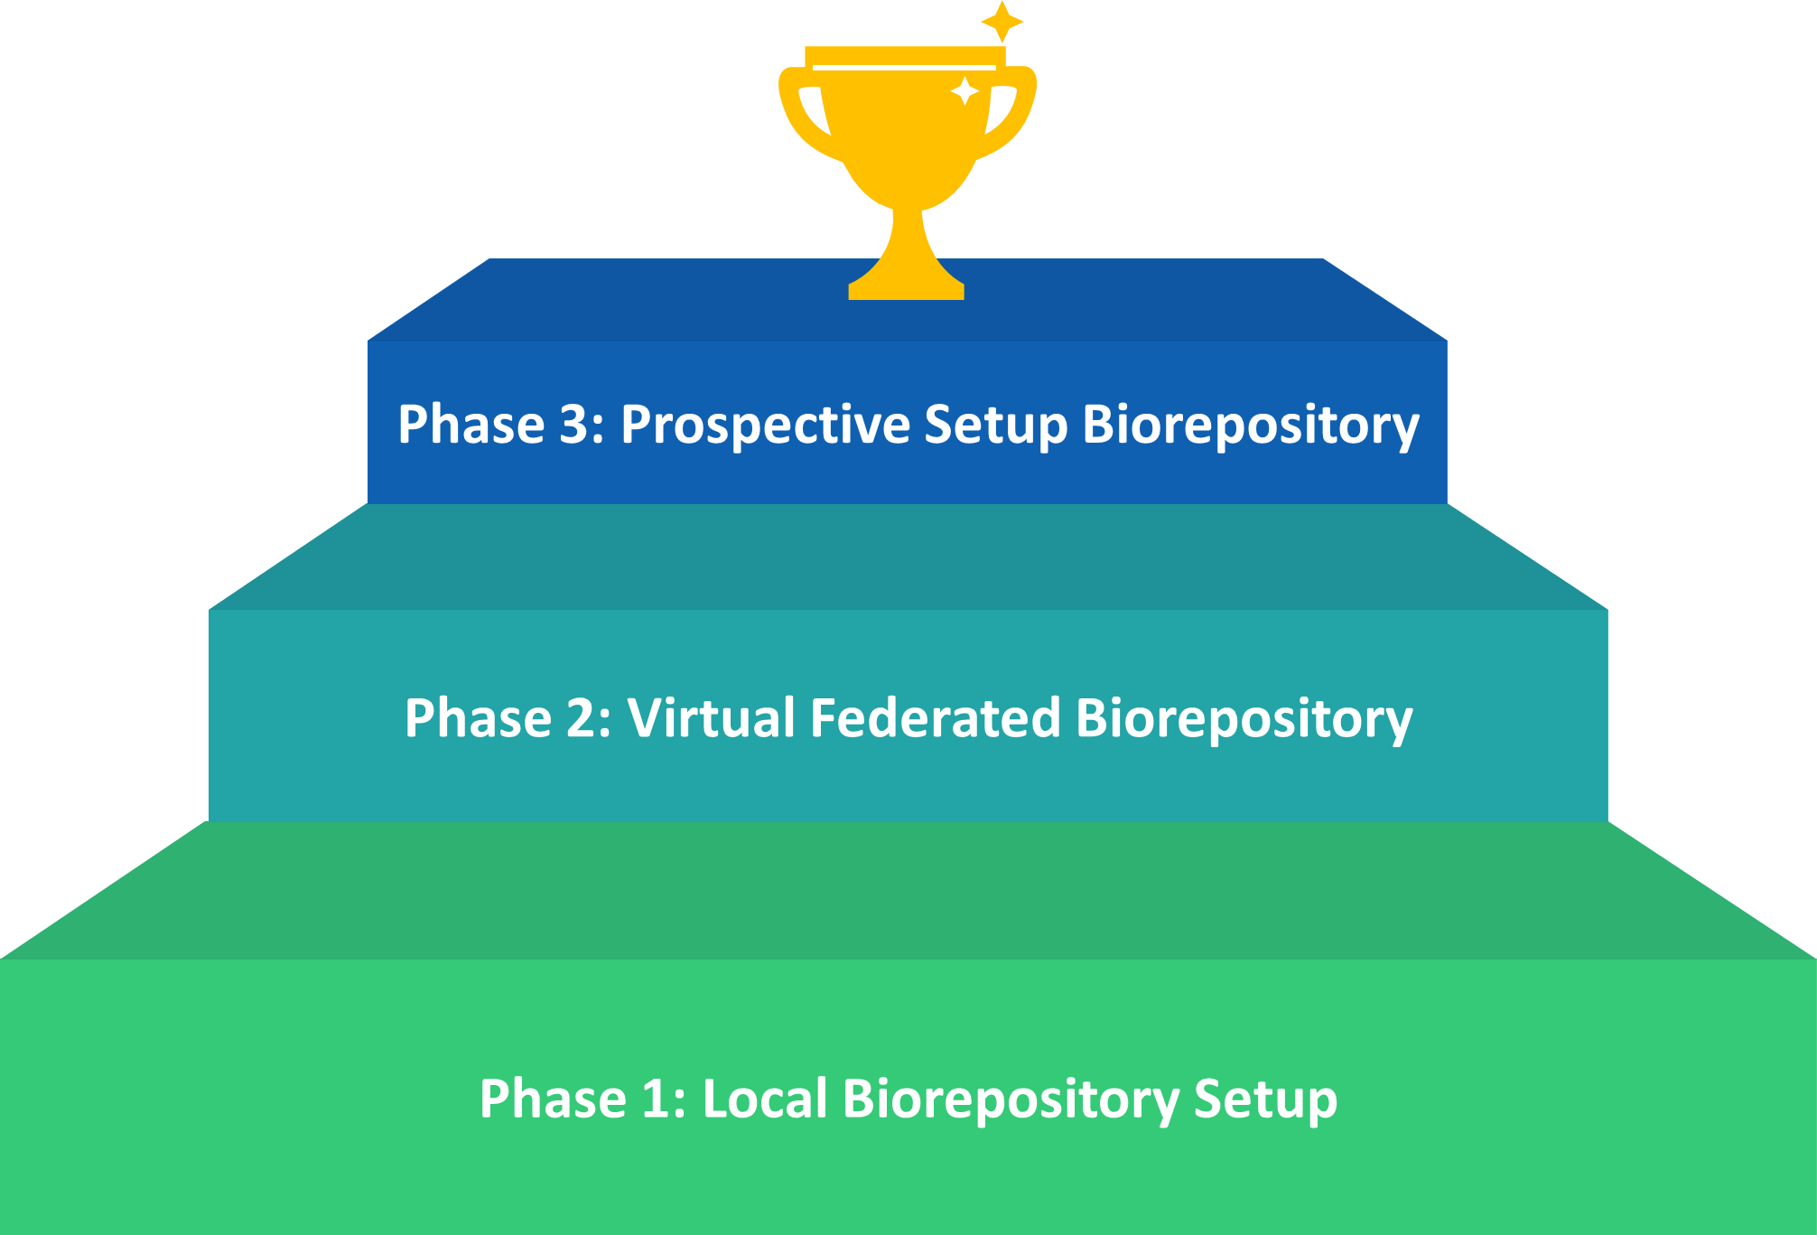
Establishment and Oversight: Phases
Collection Methods
Prospectively collected
Consent-driven specimen collection
Phase 3: Centralized Model
Clinical discards
Phase 2: Mixed Virtual Federated and Centralized Model
De-identified specimens
linked to PII via honest broker
Irreversibly De-identified specimens
Phase 1: Virtual Federated Model

Slide 10
Governance and Structure
Principal Investigator at ORD with site-PIs at VAMCs
Federated Structure administered at ORD and local VAMCs
Executive Steering Committee
Central IRB driven process
A ‘catch-all’ system to access all bio-specimens
Role of a Honest Broker

Slide 11
Establishment and Oversight: Management
ORD
Executive Steering Committee
VA Central IRB
Honest Broker
Expert Working Groups
Community Advisory Group
Administration
PI and site co-Is
Scientific Review Board
VAMC
Administrators and Project Managers
Investigators
Local R&D committees
Covid-19
Bio-specimen custodians
Covid-19
Database and Patient Registry

Slide 12
Establishment and Oversight: Workflow
Phase 1
and 2
VA Laboratory Medicine Service
VA R and D service
De-identified
Consent
not available
Discard
Clinical Excess
(To be discarded)
Specimens)
? Consented
retrospectively
De-identified
and
De-linked
HIPAA and
Consent
Waiver
Re-connect
to PII via
Honest Broker
Phase 3
VA R and D service
Prospectively collected bio-specimens
with consent
(Central IRB approved)
Bio-specimen
Repository

Slide 13
Governance Characteristics: Virtual Federated and mixed phases (1 and 2)
Bio-specimens to include samples from Patients Under Investigation (PUI) and Covid-19+ patients.
Bio-specimens to be stored at local sites.
Bio-specimens added to a central database
Site-PI and Honest Broker work with Central IRB to work through transfer of custody from Laboratory Medicine to R and D service
Investigator-initiated protocols to seek access to bio-specimens through Central IRB
Site PI with local R and D committees to prioritize allocation

Slide 14
Governance Characteristics: Centralized Phase 3
Bio-specimens collected with consent-driven process via Central IRB
Bio-specimens collected, coded and shipped to central location.
Bio-specimens added to a central database
Investigator-initiated protocols to seek access to bio-specimens through Central IRB
Executive Steering Committee to oversee allocation and distribution of samples
Executive Steering Committee to liaison with other bio-repositories

Slide 15
Specimen Collection Protocol Development
Two principles suggested by the working group:
  Save existing remainder clinical specimens.
  Collect specimens for current and future research.
These principles were discussed with Director, ORPP&E and Chief, Pathology and National Director, Pathology & Laboratory Medicine Services.
Two draft protocols presented here.

Slide 16
“Sweep” Remainder Clinical Specimens Protocol
Definition: collected for clinical purposes, saved in lab for test verification, validation or other purposes, not collected with intent for research; SARS-CoV-2 positive or negative. A ‘once and done’ protocol, meaning we use it to ‘sweep’ existing samples. Future donors of clinical remainder samples (or other specimens not immediately designated for research) must be consented.
Protocol:
IRB-exempt
Documentation of informed consent waived
HIPAA authorization waived
Samples assigned an identifying number or code
  Can be used for operations (e.g. assay validation)
  Can be used for (future) research protocols
  Can be linked to minimum necessary PII and PHI with justification

Slide 17
“Sweep” Remainder Clinical Specimens
Protocol, continued:
Multisite protocol, VA-CIRB reviewed
Local R&D review
Specimens stored locally or shipped to central interim biorepository
Timeline dependencies:
Working Group review/approval.
VA-CIRB review/approval.
Local R & D committee approval.
Local sites processes determined.
Local and central biorepository site preparations.

Slide 18
National Multisite Specimen Collection Protocol
Definition: Specimen collection for current and future research. Not COVID-19 specific.
Multisite protocol, VA-CIRB review
Donors consented; HIPAA authorization done.
Local R&D review.
Specimens coded; able to be linked to PII and PHI.
Donors approved for specimen collection by a care provider.
Blood volume collected is monitored and in accordance with local limits.
Donors compensated.

Slide 19
National Multisite Specimen Collection Protocol
Consent active for ? 1 year (tbd).
Covers many/most specimens that could be used for research.
Re-contact of donors allowed.
Storage and future use allowed until sample is depleted.
Genetic/genomic testing allowed.

Slide 20
Specimen Collection Protocols--Summary
not specific for SARS-CoV-2 and COVID-19
allows one-time ‘sweep’ and preservation of existing clinical remainder samples—especially needed for immediate operations use
flexible about storage location (allows local interim storage while central or federated or collaborative biorepository is created)
puts in place future specimen collection system for research, but specimens are not pre-dedicated to a project

Slide 21
Sample Collection
The actual sample types span a large range of possible utility and application
The overall objective is to advance scientific understanding. Therefore, facilitating the communications between those collecting samples and those working with them is critical.
We envision that there should be as many investigator-to-investigator (ITI) connections as possible in order to build the research collaborative networks within the DVA.
We recommend that the DVA poll physician care providers, pathologists and researchers for the samples that they are in a position to collect and are interested in using.

Slide 22
Sample Collection
Sample types that may be more infectious than others:
  Nasopharyngeal Swab (NS)
  Sputum
  Saliva
  Bronchioalveolar Fluid (BAL)
  Will require specific instructions on collection, storage and shipping. Possible ITI collaborations

Slide 23
Sample Collection
Sample types require expertise in collection or interest in use, that may depend upon ITI connections initially:
-Peripheral blood mononuclear cells (PBMC)
-Biopsies
-Autopsy tissues
-Hair & Finger Nails
-Urine
-Stool

Slide 24
Sample Collection: remnant serum/plasma samples
Discarded Serum/Plasma collection from VA Pathology Labs for the DVA Covid-19 BioRepository (Need Central Office IRB or if site has own, fine)
Database screen for “lab request for COVID19 test”
Sample identified by Pathology Lab personnel and set aside
After 3 days serum/plasma is aliquoted, labeled, frozen (-20ºC), saved until regulatory and compliance issues are resolved, divided for local interests, and shipped to Palo Alto
-Size of aliquots: first 5 aliquots 0.5mL, remainder in 10mL conical tube
-Labeling: site#, Subject ID#, “draw#”, day since COVID19 test (barcode labels could be premade and distributed to sites, work with “sample tracking/storage” group)
-Store, divide, and ship

Slide 25
Virtual Federated Biorepository (LIMS)
General Principles:
1. Ability for Sample collection at multiple sites.
  Sample accessioning at collection sites
  Discarded or project based sample acquisition
  Sample collection information and metadata capture
  Local temp storage and shipping to long-term storage centers

Slide 26
Virtual Federated Biorepository (LIMS)
General Principles (Cont’d):
2. Sample storage at one or more central Biorepositories (as needed).
  Expected Sample shipping information
  Sample accessioning into central biorepositories
  Sample Processing workflow with metadata capture
  Storage workflow - Freezer information
  Shipping workflow to assay labs, etc.

Slide 27
Virtual Federated Biorepository (LIMS)
General Principles (Cont’d):
3. LIMS system
  Role based tiered access controls (you see what your role needs to see)
  Each site/labs have independent access to system to perform their role/action in the sample custody chain
  Centralized administration for operationalization of harmonized processes and SOPs
  Honest Broker System for governance/permission based integration of sample to other data (clinical/molecular/health)

Slide 28
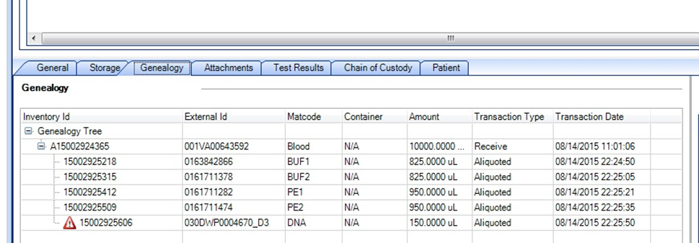
Virtual Federated Biorepository (LIMS)
Capturing Transactional history of the Sample

Slide 29
In Summary
The VA COVID-19 Biorepository system is early in its planning stages
The Working Group is proposing a means to collect current remnant/remainder clinical specimen for future validation and testing
The Working Group is proposing a second broader protocol for sample collection for research (both remnant/remainder samples and samples specific for research protocols)
The Biorepository system would be a
  comprehensive repository of COVID-19 and other emerging infectious diseases specimens and associated data available for research studies in order to advance scientific understanding of this disease and further diagnostic, therapeutic and prevention strategies for immediate deployment in clinical environments.
  model repository for other diseases and conditions affecting veterans.
  way to enhance collaboration with external partners focused on COVID-19 and other emerging infectious diseases research.
  Mechanism to harmonize specimen and data collection procedures across clinical sites.

Slide 30
Biorepository Input Needed
Would the Biorepository Network as presented be an asset to you and other VA researchers?
  If not, what is missing?
Do the two protocols meet your needs?
  If not, what is missing?
To comment, please email:
  ORDCOVID19@va.gov with ‘Specimen Collection’ in subject line

Slide 31

THANK YOU AND QUESTIONS

Slide 32
AVAILABILITY OF RECORDING
A recording of this session and any associated handouts will be available on ORPP&E’s Education and Training website approximately one week post-webinar.
https://www.research.va.gov/programs/orppe/education/webinars/archives.cfm

